Slide 1

INDIAN JOB MARKET ANALYSIS and Forecasting
- Ashanvit Nandagawali

Slide 2
📌 Objective :
The goal of this project is to analyze the current trends in the Indian IT job market using real job listing data sourced from top job portals. We aim to:
🔍 Identify hiring and employment patterns
💰 Understand salary distributions and in-demand skills
🏢 Explore the hiring behavior of top companies
This analysis will help job seekers, employers, and policymakers make data-driven decisions.

Slide 3
🛠️ Tools & Techniques :
💻 Platform: Jupyter Notebook
🐍 Language: Python
📚 Libraries Used:
Pandas and NumPy for data cleaning and manipulation
Matplotlib and Seaborn for data visualization
Warnings to suppress unnecessary outputs

Slide 4
📈 Analytical Approach :
Loaded the dataset using Python (Pandas) for analysis.
Cleaned the data by handling missing values and dropping irrelevant columns.
Performed Exploratory Data Analysis (EDA) to study trends in roles, companies, salaries, and locations.
Created visualizations (bar charts, pie charts, subplots) using Matplotlib and Seaborn.
Extracted key insights and summarized the overall job market trends.

Slide 5
📊 VISUALIZATION (EDA) :
Top 10 Most Trending IT Job Titles in India.
Top 10 Companies with Most Job Listings in India.
Jobs by Education Requirement.
Experience Required Distribution.
Salary Range.
Job Type Distribution.
Remote vs Onsite Job Listings.
Salary Range vs Experience Required.
Job Portal Distribution.
Job Postings Over Time.

Slide 6
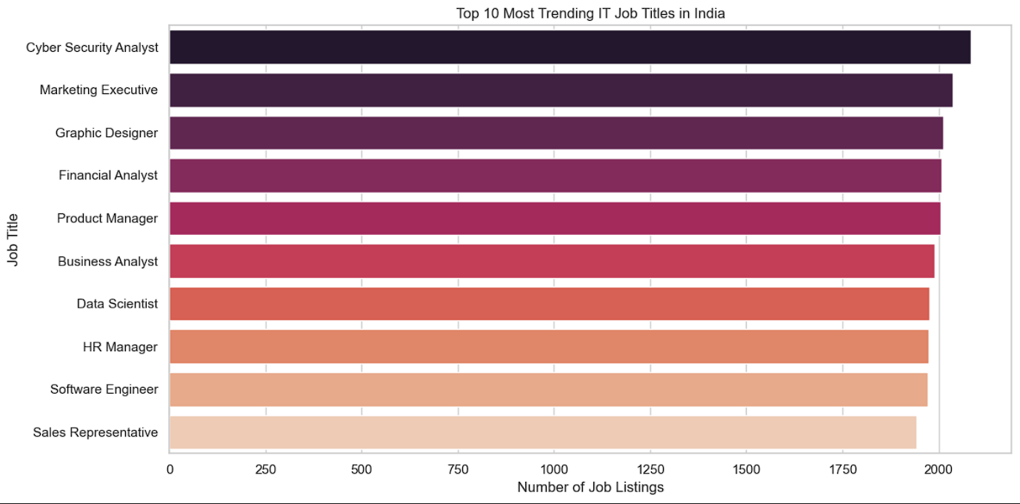
🔥 Top 10 Trending IT Job Titles :
🔎 Insight:
The most in-demand job title in the Indian IT market is Cyber Security Analyst, which indicates a sharp rise in demand for cybersecurity skills. This is likely due to the increasing number of cyber threats, data breaches, and digital frauds happening across industries.
The job market is favoring technically advanced, security-focused, and data-driven roles. This is a signal to aspiring professionals to upskill in areas like cybersecurity, cloud computing, and data analysis.

Slide 7
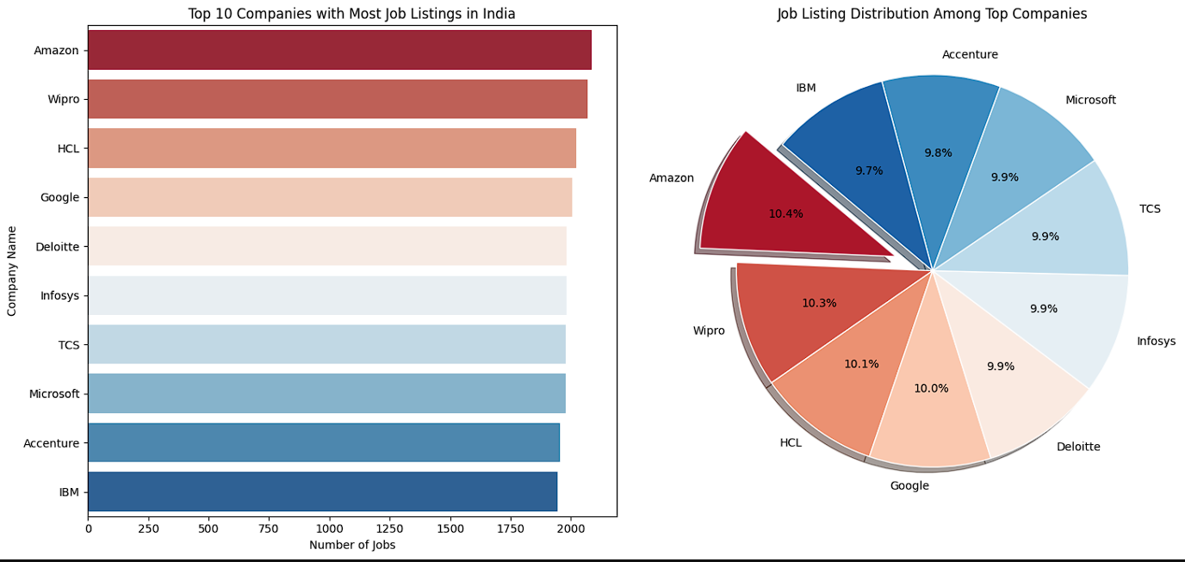
🏢 Top 10 Companies with Most Job Listings :
🔎 Insight:
Amazon tops the list with the highest number of job postings, followed closely by Wipro, HCL, and Google. These are all global tech giants with diverse digital projects in India.
Big tech companies are aggressively hiring, showing that India remains a core hub for IT operations and digital transformation.

Slide 8
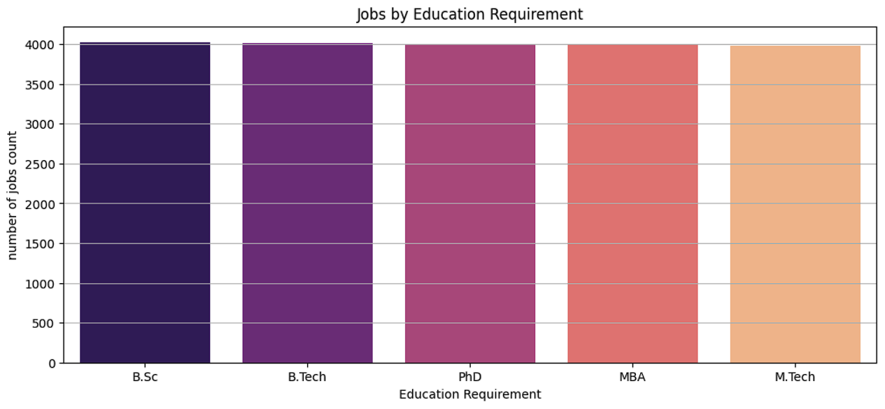
🎓 Jobs by Education Requirement :
🔎 Insight:
Most IT job listings demand a Bachelor’s degree as the minimum qualification. There is not a significant difference in the number of jobs requiring Master’s or Diploma-level education.
The IT industry prioritizes skills and practical knowledge over advanced degrees. A Bachelor’s degree (often in CS or related fields) paired with the right certifications and portfolio can open doors, even in top firms.

Slide 9
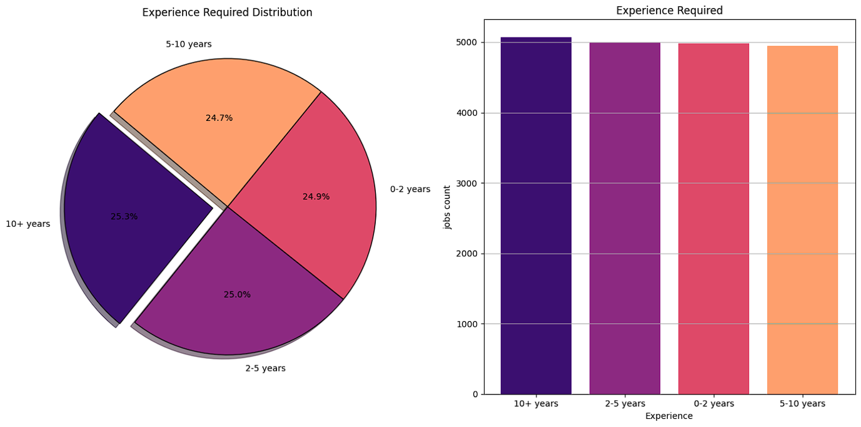
📈 Experience Required Distribution :
🔎 Insight:
The majority of job roles demand 2+ years of experience, with a clear shift toward mid-level and senior professionals.
Companies value industry exposure and project experience. However, internships and fresher-level jobs are still present, which is promising for new graduates. Still, early career candidates should focus on gaining hands-on project experience or internships to stay competitive.

Slide 10
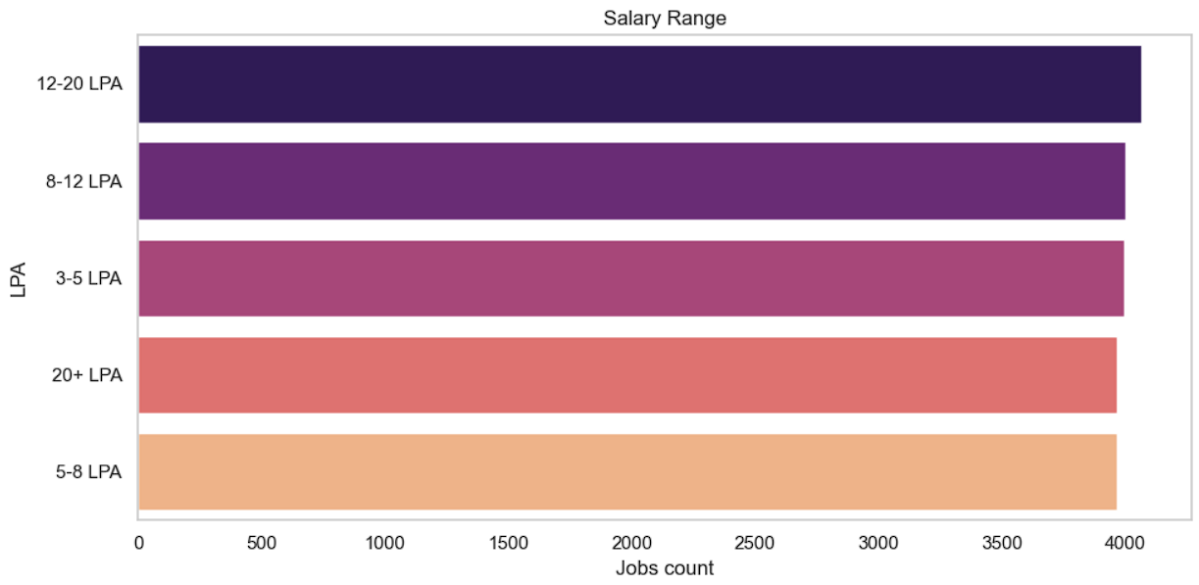
💰 Salary Range Distribution :
🔎 Insight:
Most jobs fall into the 12–20 LPA range, which is relatively high. The presence of salaries above 25 LPA is primarily tied to senior roles or niche technical skills.
The market is willing to pay well for skilled candidates, especially in areas like cybersecurity, data engineering, and DevOps. Upskilling in hot tech areas can lead to significantly higher pay.

Slide 11
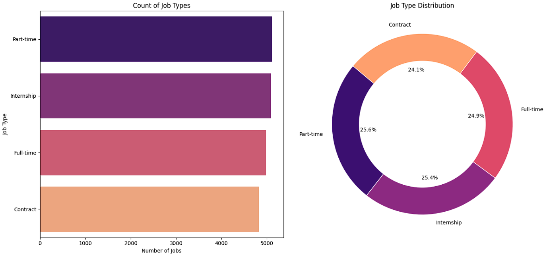
⏳ Job Type Distribution :
🔎 Insight:
A large number of roles are part-time, contract-based, or internships, which is a shift from traditional full-time-only hiring.
There is a growing flexibility in employment types, giving students, freelancers, and gig workers more opportunities. This also suggests that companies are open to cost-effective, project-based hiring strategies.

Slide 12
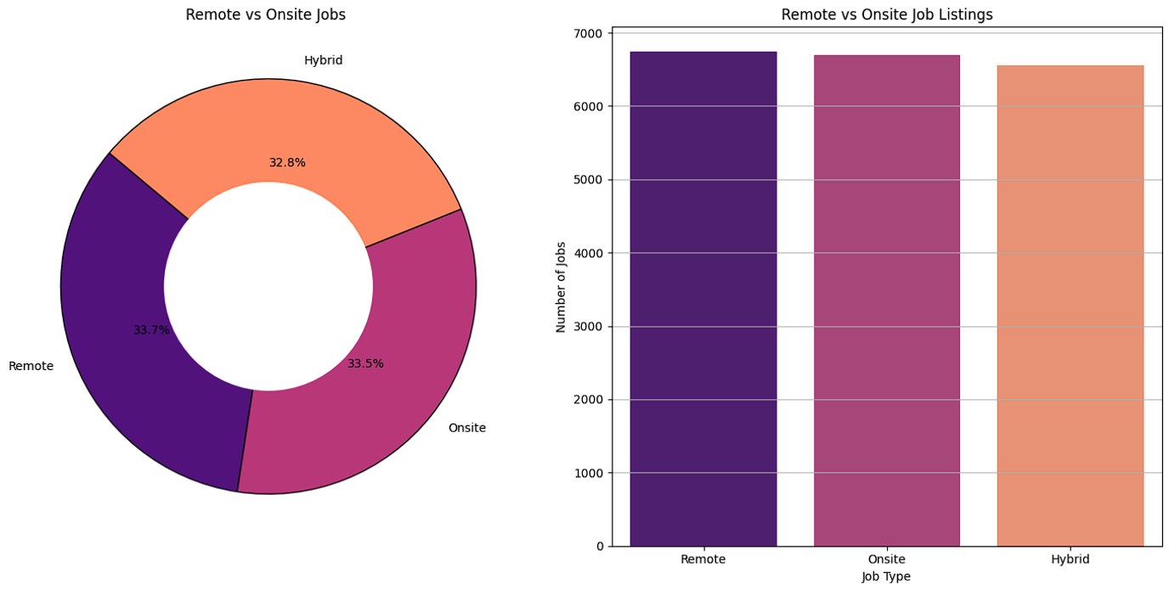
🏡 Remote vs Onsite Job Listings :
🔎 Insight:
The distribution among remote, onsite, and hybrid jobs is quite balanced, reflecting a post-pandemic shift in work culture.
Companies are increasingly allowing employees to choose where and how they work, which is a big win for work-life balance. Remote work is becoming a mainstream norm, not a niche offering.

Slide 13
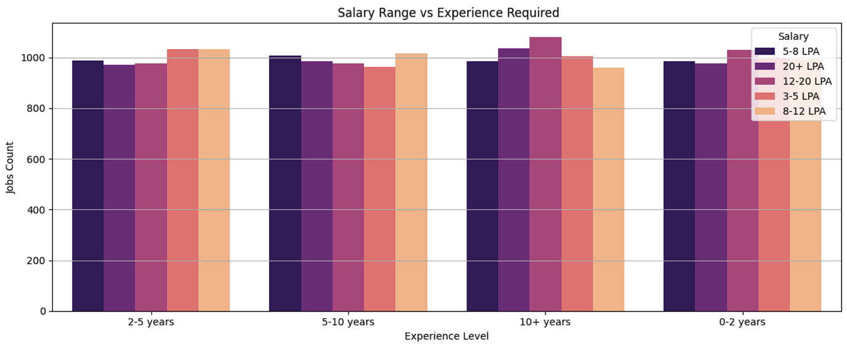
🔄 Salary Range vs Experience Required :
🔎 Insight:
There’s a strong correlation between experience and salary. Entry-level jobs offer lower packages, while 5+ years of experience can land salaries above 20 LPA.
To boost earning potential, candidates should aim for continuous learning, certifications, and project-based experience. Experience isn't just about years—it’s also about demonstrated value.

Slide 14
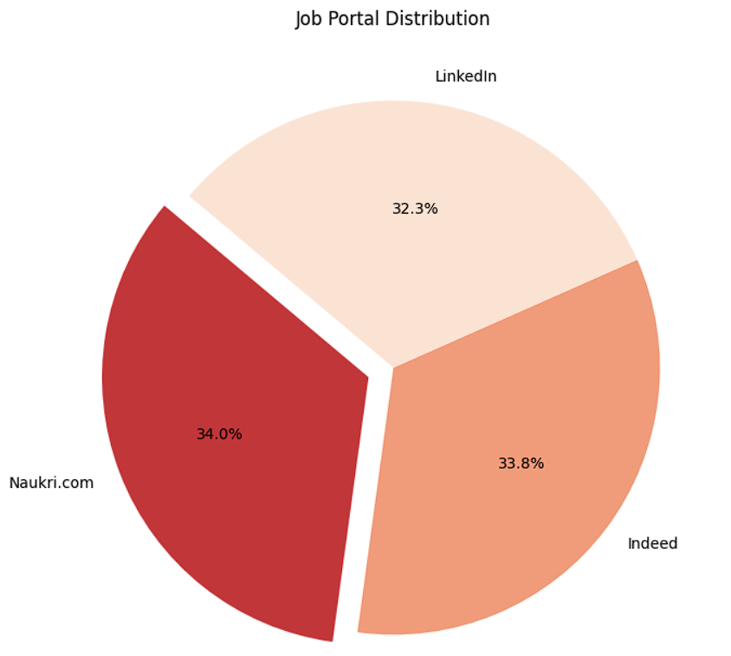
🌐 Job Portal Distribution :
🔎 Insight:
While multiple portals contribute job listings, Naukri.com leads the way with the highest number of listings. Others like LinkedIn, Indeed, and Monster follow closely.
Job seekers should prioritize Naukri.com for job hunting, but maintaining a presence across platforms improves visibility and application success.

Slide 15
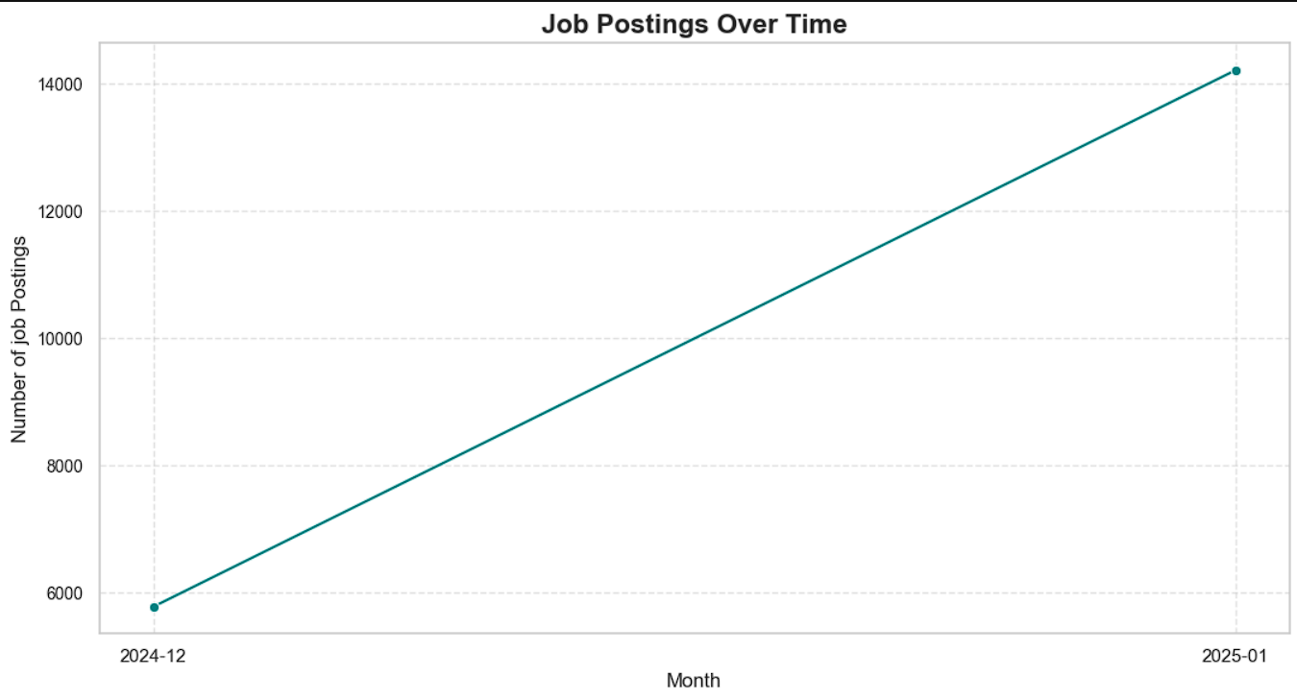
📅 Job Postings Over Time :
🔎 Insight:
There is a steady upward trend in job listings month over month. This shows a recovering and expanding IT job market.
Despite global economic shifts, India’s IT sector is growing steadily, making it a favorable time for job seekers to enter or switch their careers in tech.

Slide 16
Forecasting Future Job Postings with ARIMA :
📊 Objective
To anticipate upcoming hiring trends in the Indian IT market, we applied the ARIMA (AutoRegressive Integrated Moving Average) model to forecast monthly job postings over a 6-month period.
This helps in:
📌 Guiding job seekers on when to apply and which skills to target
📌 Helping recruiters and businesses plan their hiring pipelines
📌 Supporting policy and training institutions in workforce planning
🧠 Model Details
Component | Description
📈 Model Type | ARIMA (2, 0, 2) — auto-regressive model with no differencing, and 2 lags each for AR & MA
📅 Forecast Range | January 2025 – June 2025
📊 Training Data | Simulated job postings (monthly) from Jan 2023 to Dec 2024
🛠️ Tuning Method | RMSE-based grid search (tested various p, d, q combinations)

Slide 17
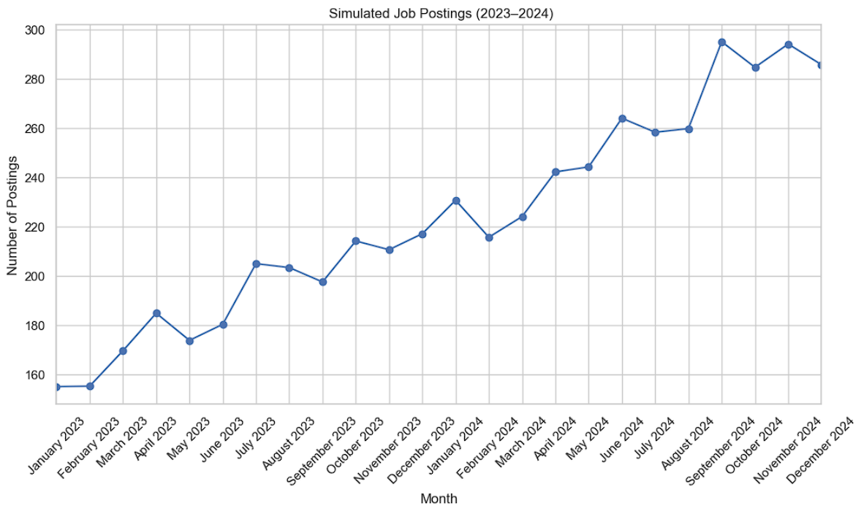
Simulated Historical Job Postings (2023–2024)
📊 About the Data
This chart represents 24 months of simulated job posting data, from January 2023 to December 2024.
Data was generated with a gradual upward trend and realistic random noise to reflect market behavior.
Consistent Growth: Clearly visible upward movement shows increasing demand over time.
This time series was used as training data for the ARIMA model, making it essential to the accuracy of the 2025 forecast.

Slide 18
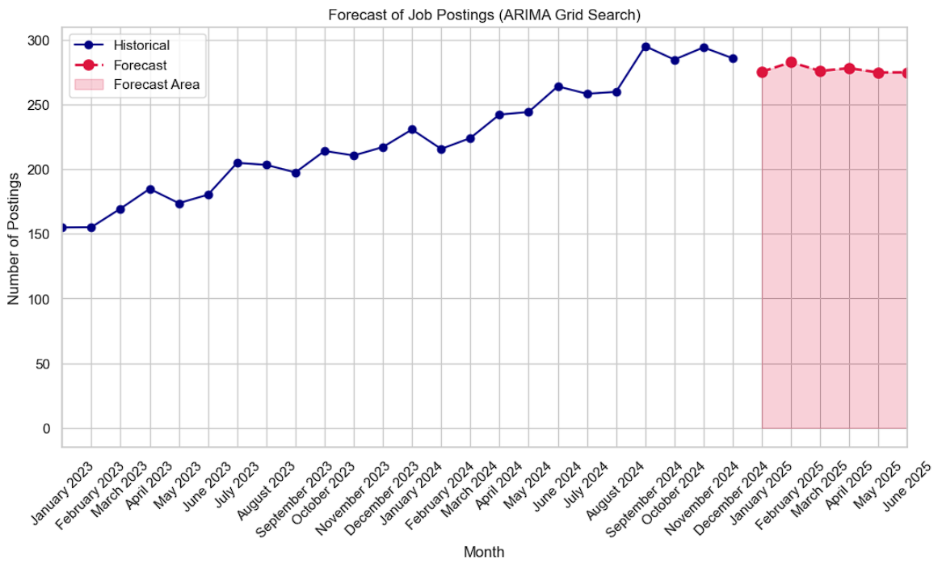
ARIMA Forecast for Jan–Jun 2025
This graph presents the ARIMA-based forecast of job postings for the period January 2025 to June 2025, following analysis of historical trends from 2023–2024.
🔍 Visuals :
🔴 Red Dots: Forecasted job postings for each of the next 6 months
🟥 Shaded Area: Indicates the forecasted region, helping to visually separate future estimates from historical data
📈 Forecast Pattern: Trendline suggests a stable to slightly increasing job demand — a positive sign for the IT job market in early 2025

Slide 19
🧠 Strategic Insights from Job Market Forecasting :
✅ Job demand remains stable to slightly rising through early 2025, showing continued IT sector growth.
📊 The ARIMA(2, 0, 2) model captures trends reliably without differencing, ideal for short-term forecasting.
👩‍💼 Recruiters can use the forecast to plan hiring timelines and budgets effectively.
🎯 Job seekers gain clarity on when to apply and what roles to target.
🏛️ Policy-makers and training providers can align skilling initiatives with projected hiring peaks.
🎓 Learners are empowered to upskill in advance of forecasted demand.
💼 Companies can time recruitment drives and resource allocation more efficiently.
🔍 Overall, short-term forecasting turns data into actionable strategy for the entire job ecosystem.

Slide 20
🟦 Conclusion & Forecast Outlook 🧾:
The Indian IT job market is growing steadily, fueled by demand for cybersecurity, flexible work structures, and skills-based hiring. Opportunities are expanding for both experienced professionals and freshers, creating a more inclusive hiring environment.
Key trends include:
📈 Cybersecurity roles driving demand.
💰 Salary growth based on experience.
🏠 Remote/hybrid roles becoming mainstream.
🧑‍🎓 Rising entry-level roles driven by skills over degrees.
ARIMA(2, 0, 2) forecasting indicates steady to slightly increased job demand through mid-2025, signaling a positive hiring outlook.
Final Takeaways:
✅ Job seekers should upskill in cybersecurity, AI, and cloud technologies.
✅ Employers must offer flexibility and growth opportunities.
✅ Stakeholders should use data-driven insights like ARIMA for strategic planning.
Insight: The Indian IT sector is poised for continued growth, shaping the future of global tech employment. 🚀

Slide 21

- Ashanvit Nandagawali

